Slide 1
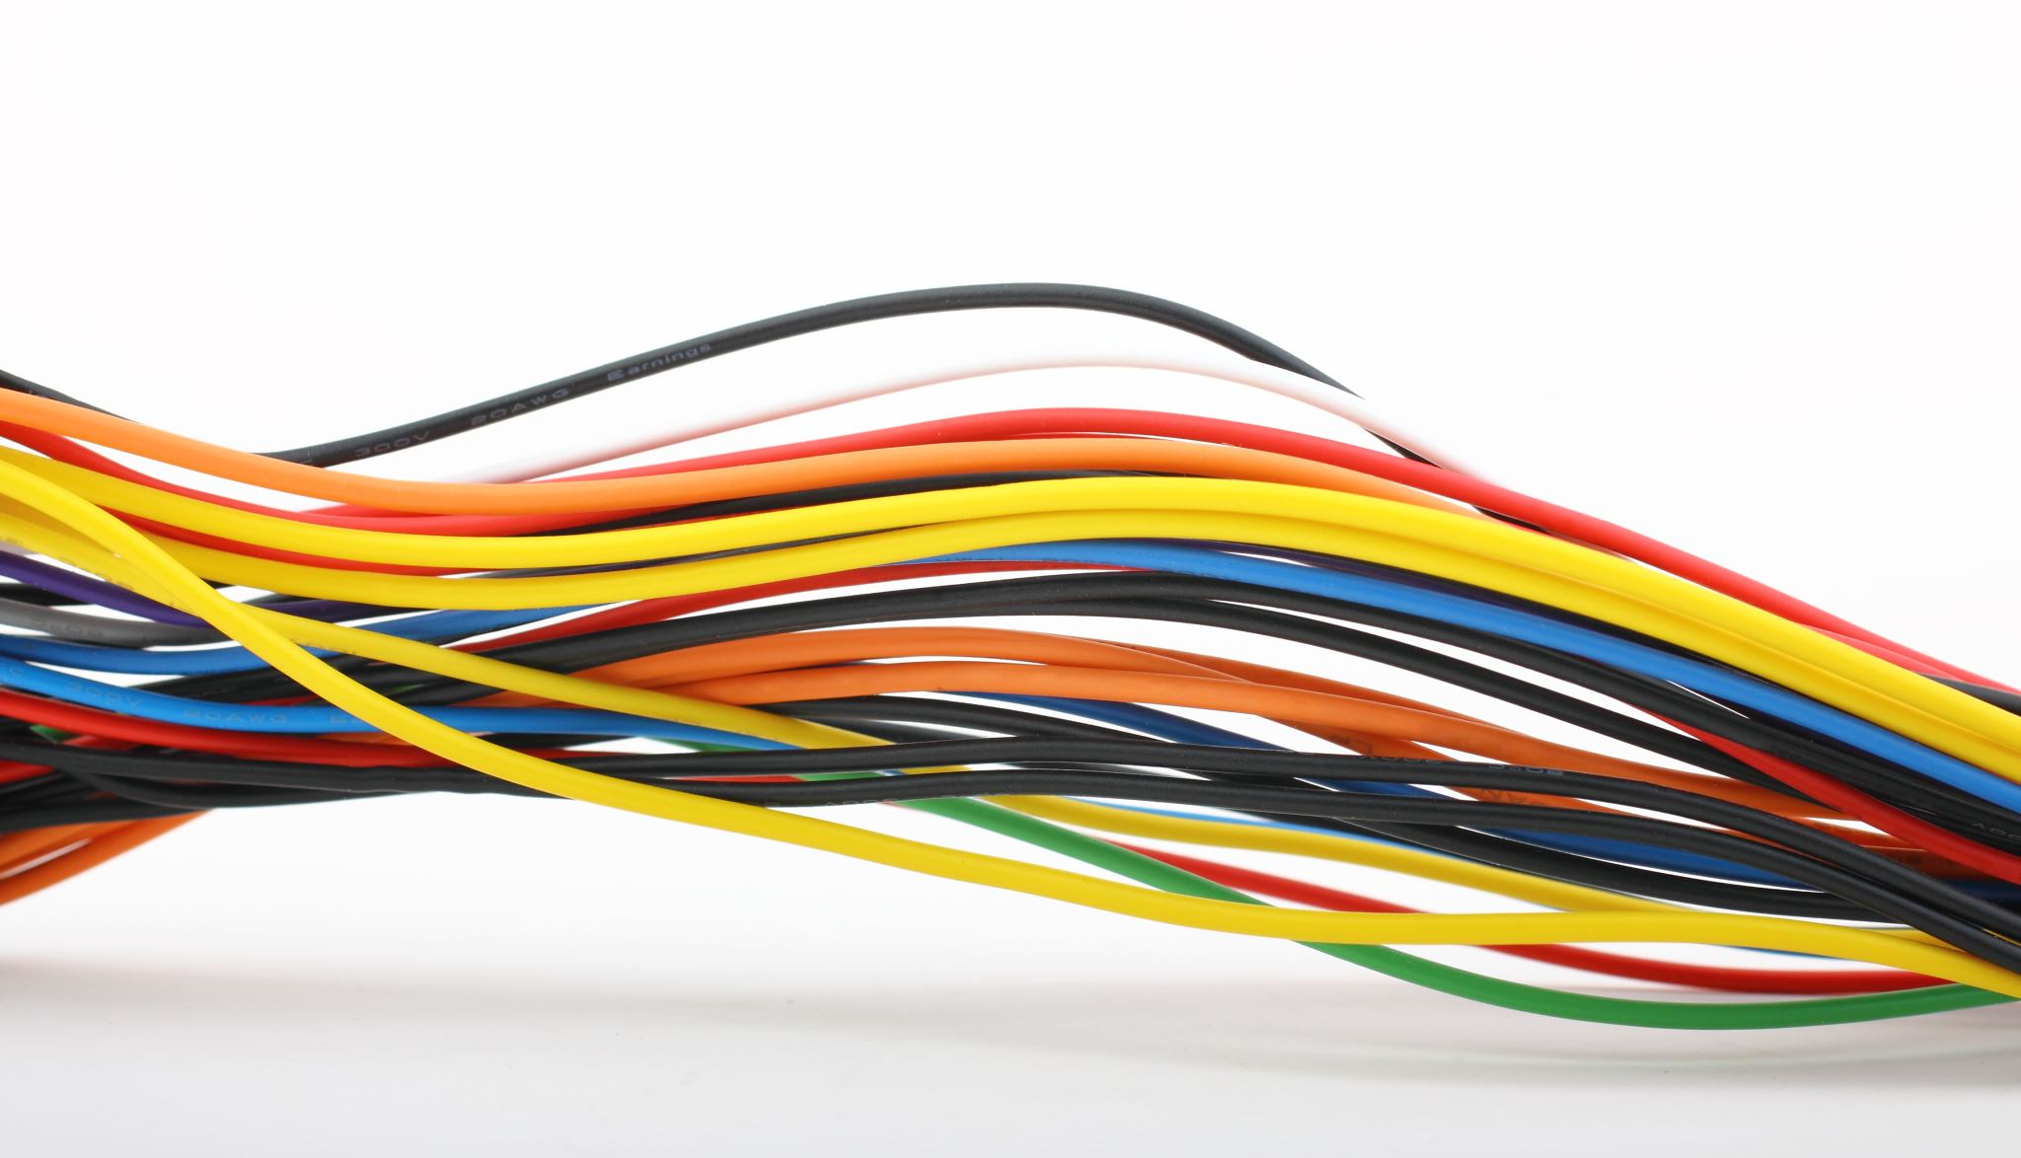
Resistance Section 2.1, 2.2, 2.3, 2.4, 2.5, 2.6
Md. Shafqat Talukder Rakin
Lecturer, Department of CSE,
United International University
Email id : shafqat@cse.uiu.ac.bd
Courtesy: Rifat Bin Rashid

Slide 2
Lecture Outline:
Series and parallel Resistance
Current And voltage division
Equivalent resistance

Slide 3
Resistance

Slide 4
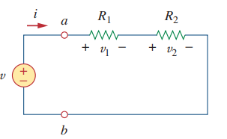
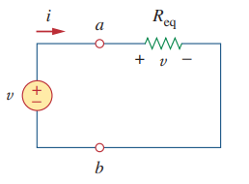


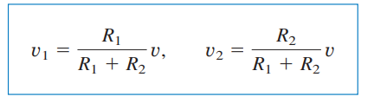
Series Resistors and Voltage Division

Slide 5
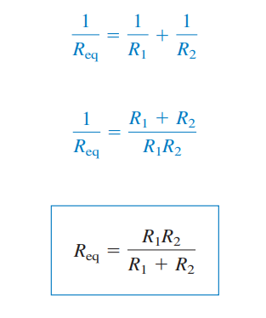
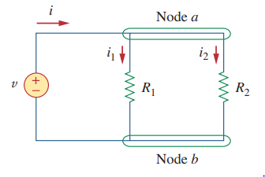

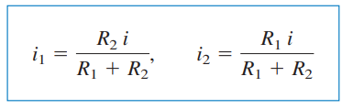
Parallel Resistors and Current Division

Slide 6
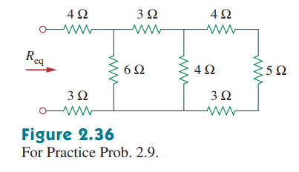
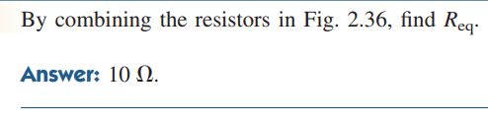
Math Problem Practice:
${Ans: R}_{\text{eq}}$ = 10 Ω
Reference: Sadiku_Practice_Problem_2.9

Slide 7
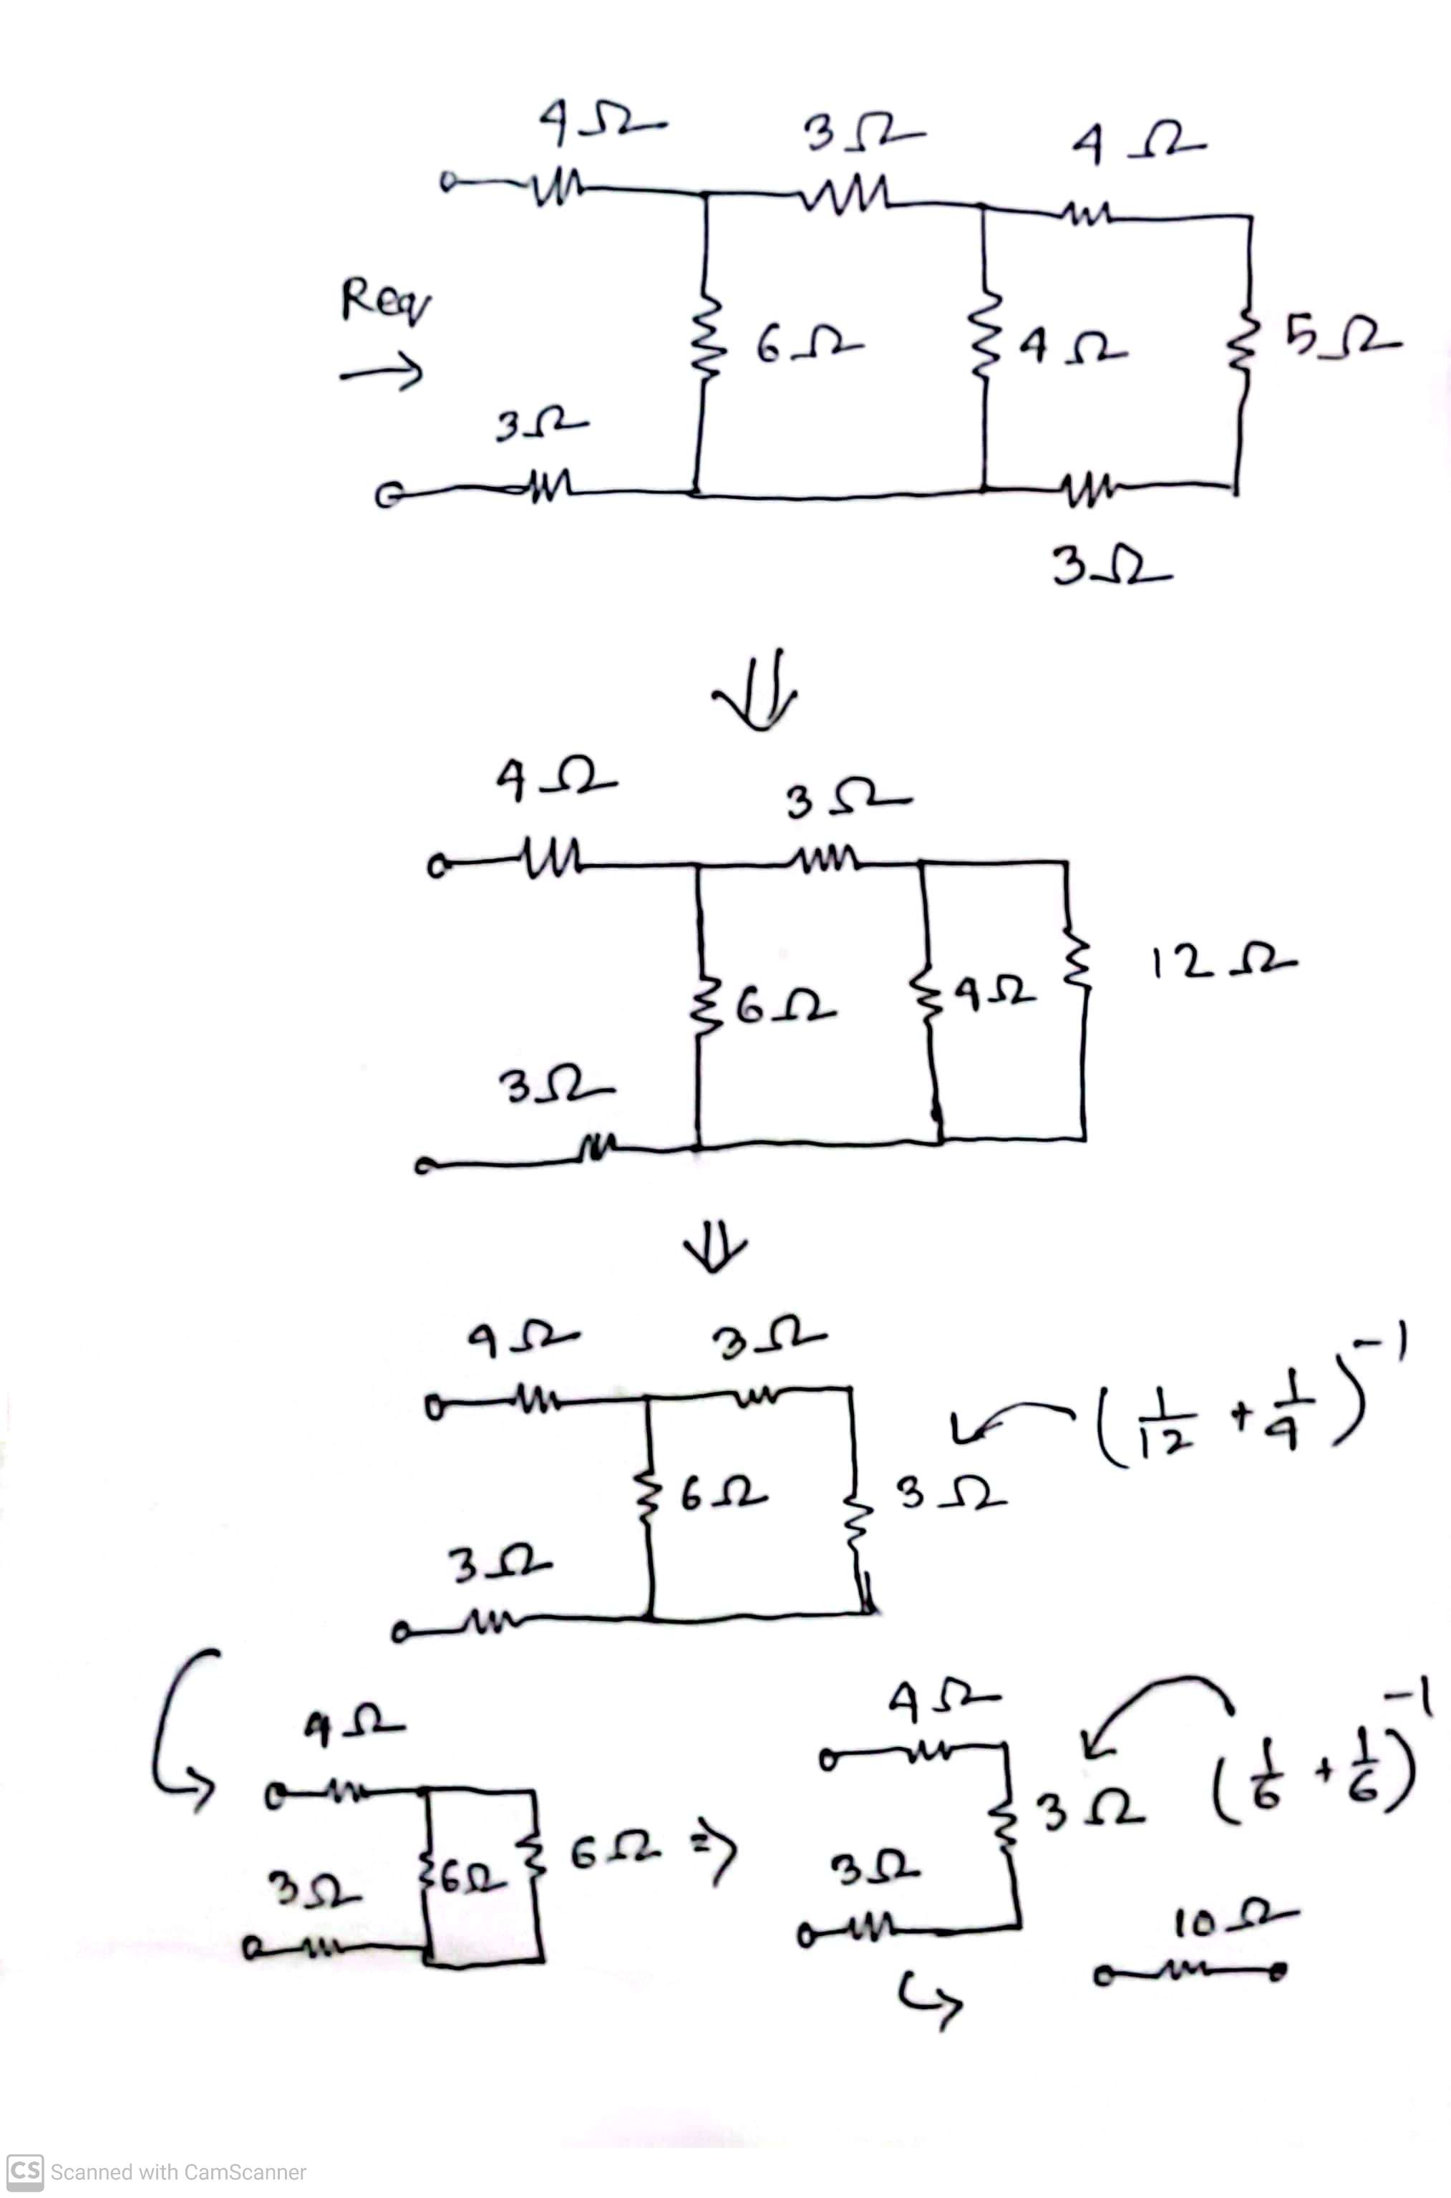
Solution of Practice problem 2.9

Slide 8
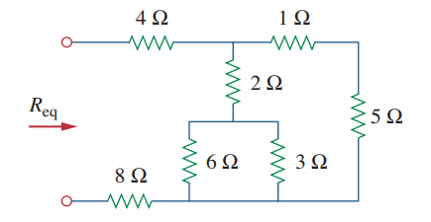
Math Problem Practice:
Find $R_{\text{eq}}$ for the circuit shown in Fig.
${Ans: R}_{\text{eq}}$ = 14.4 Ω
Reference: Sadiku_Example_2.9

Slide 9
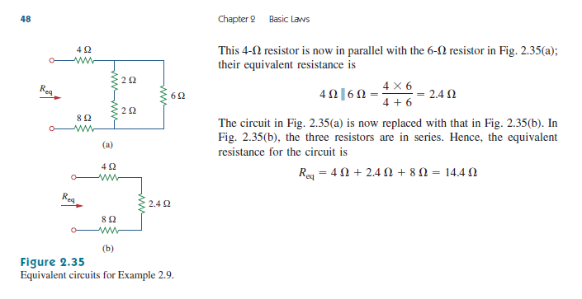
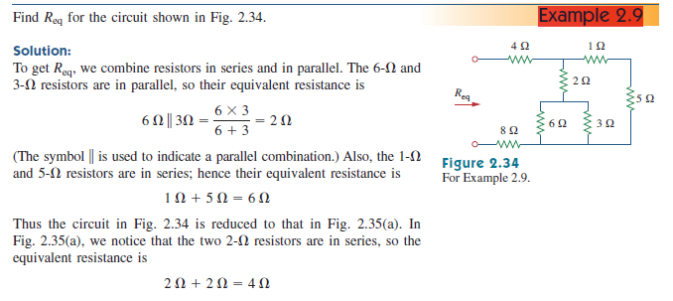
Reference: Sadiku_Example_2.9

Slide 10
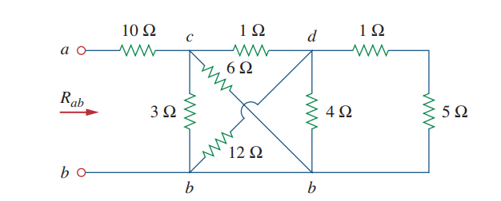
Math Problem Practice:
Find $R_{\text{eq}}$ for the circuit shown in Fig.
${Ans: R}_{\text{eq}}$ = 11.2 Ω
Reference: Sadiku_Example_2.10

Slide 11
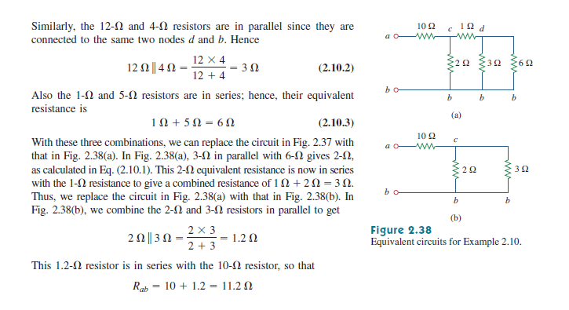
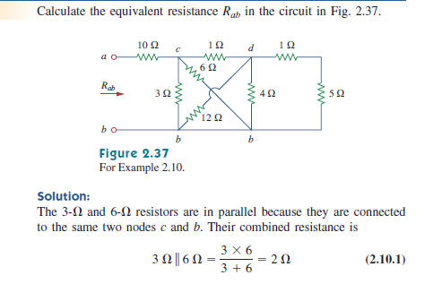
Reference: Sadiku_Example_2.10

Slide 12
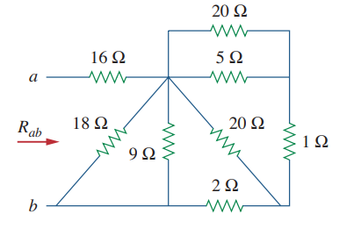
Math Problem Practice:
Find $R_{\text{eq}}$ for the circuit shown in Fig.
${Ans: R}_{\text{eq}}$ = 19 Ω
Reference: Sadiku_Practice_Problem_2.10

Slide 13
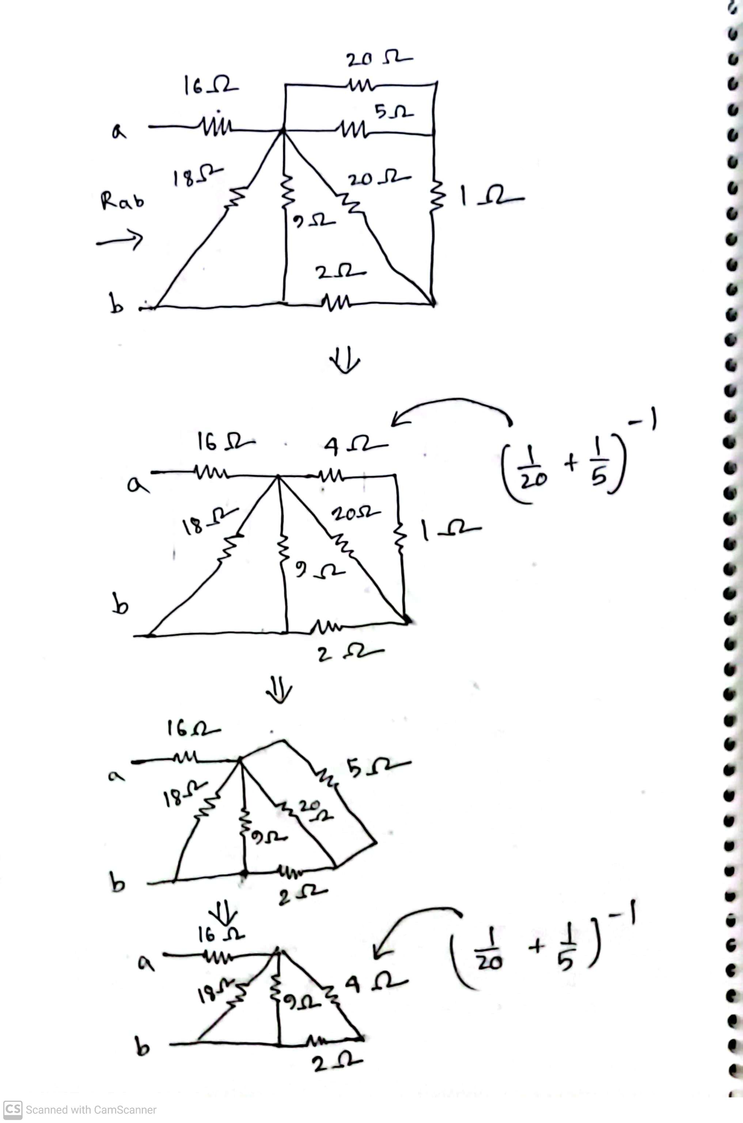
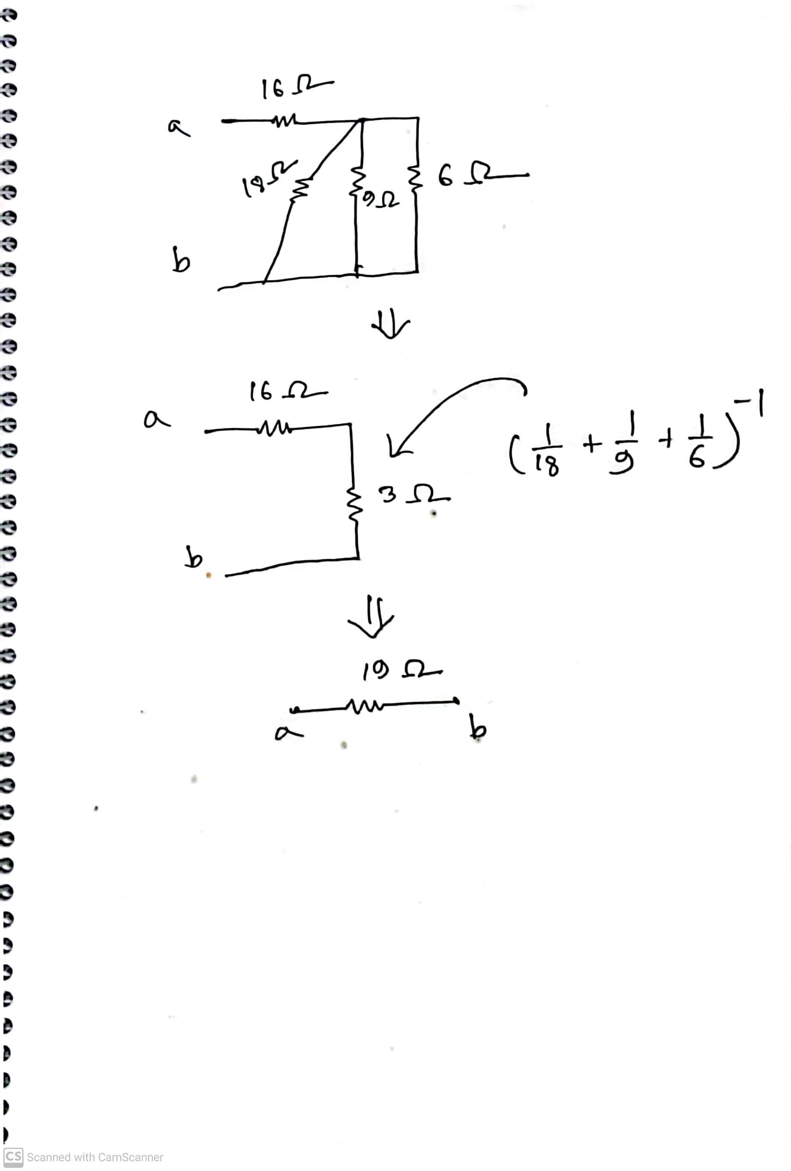
Solution of Practice problem 2.9
Reference: Sadiku_Practice_Problem_2.10

Slide 14
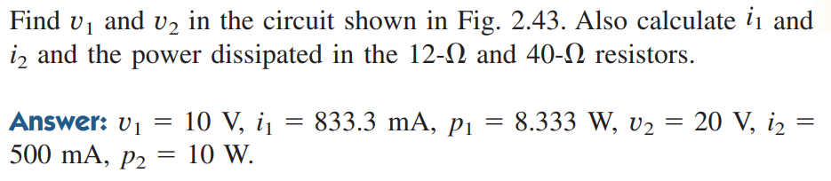
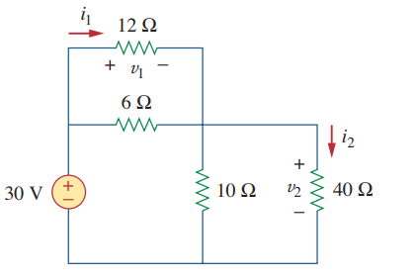
Math Problem Practice:
Reference: Sadiku_Practice_Problem_2.12

Slide 15
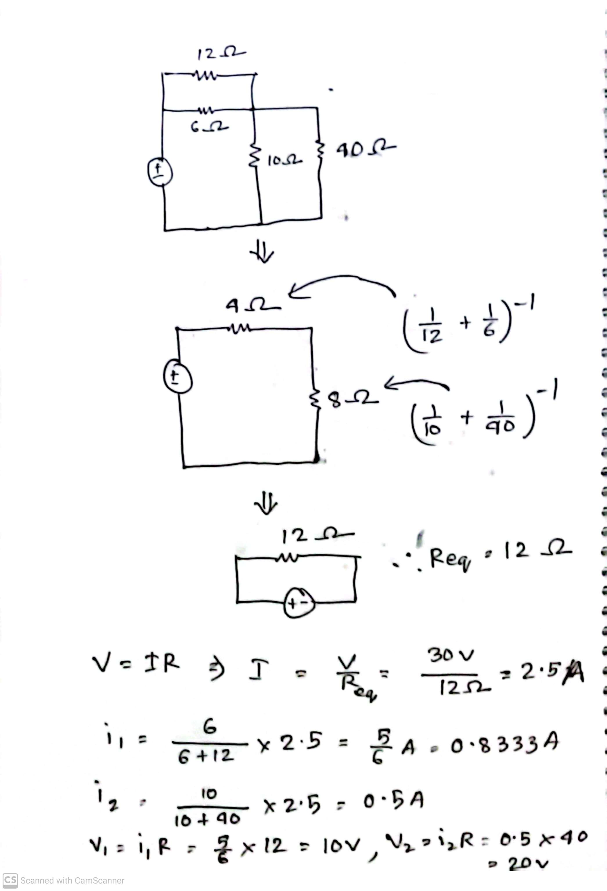
Solution of Practice problem 2.12
Reference: Sadiku_Practice_Problem_2.12

Slide 16
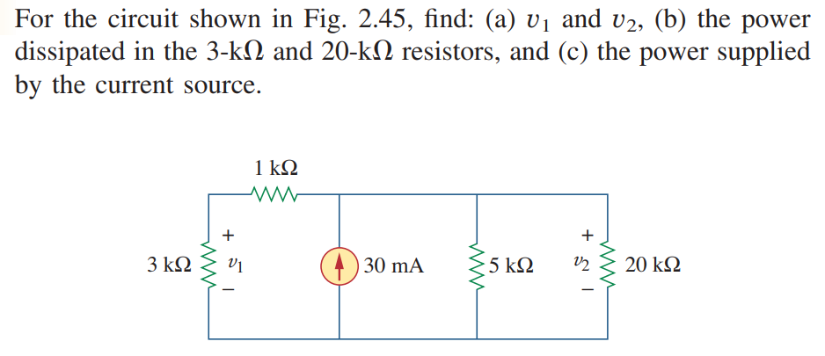
Math Problem Practice:
Reference: Sadiku_Practice_Problem_2.13

Slide 17
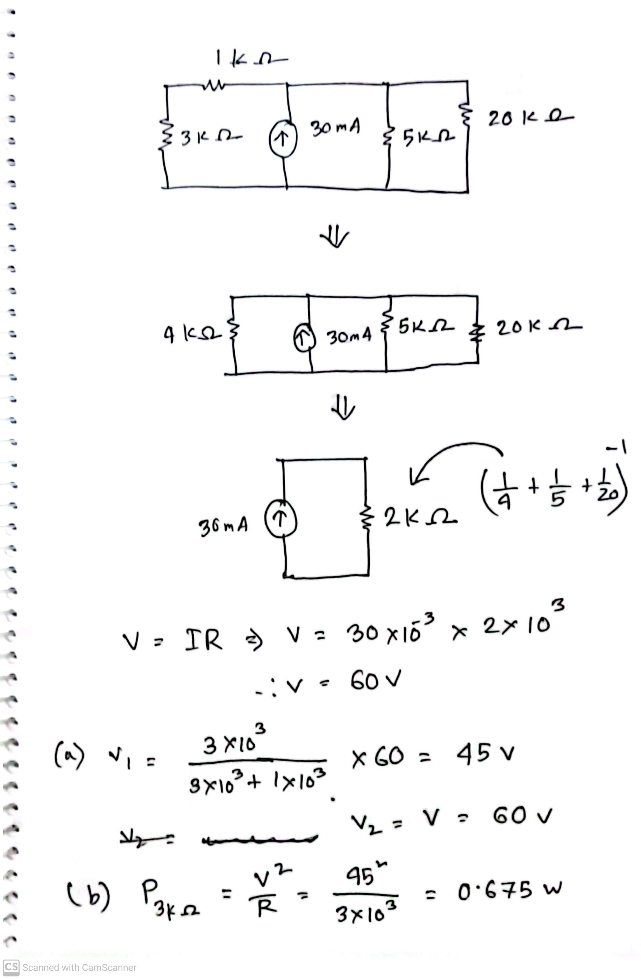
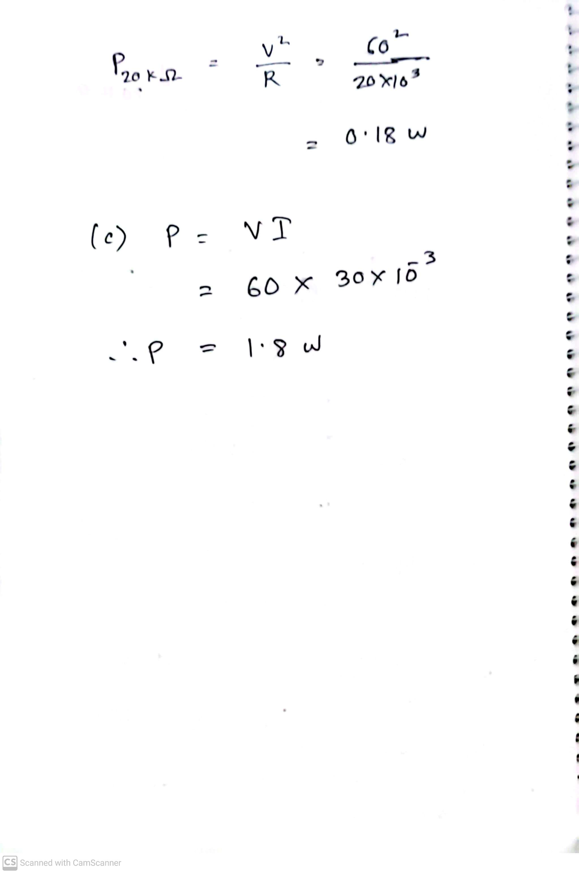
Solution of Practice problem 2.13
Reference: Sadiku_Practice_Problem_2.13

Slide 18
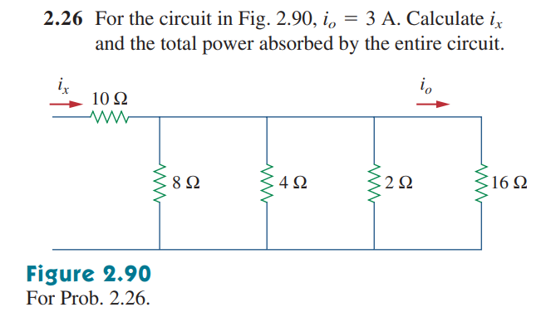
Math Problem Practice:
Reference: Sadiku_Exercise_Problem_2.26

Slide 19
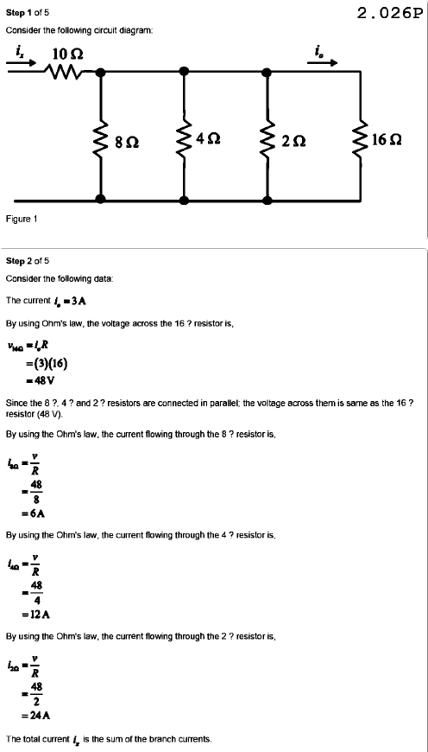
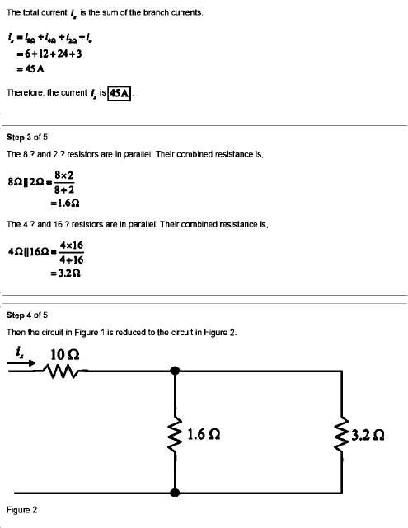
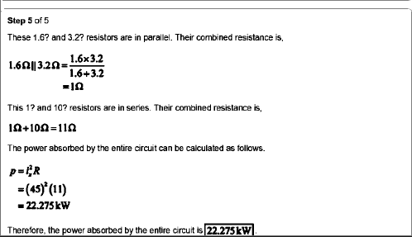
Solution of 2.26:
Reference: Sadiku_Exercise_Problem_2.26

Slide 20
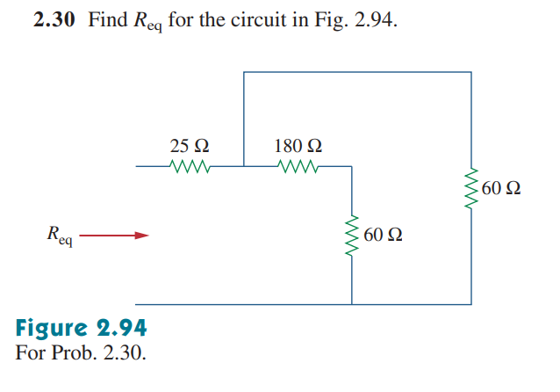
Math Problem Practice:
Reference: Sadiku_Exercise_Problem_2.30

Slide 21
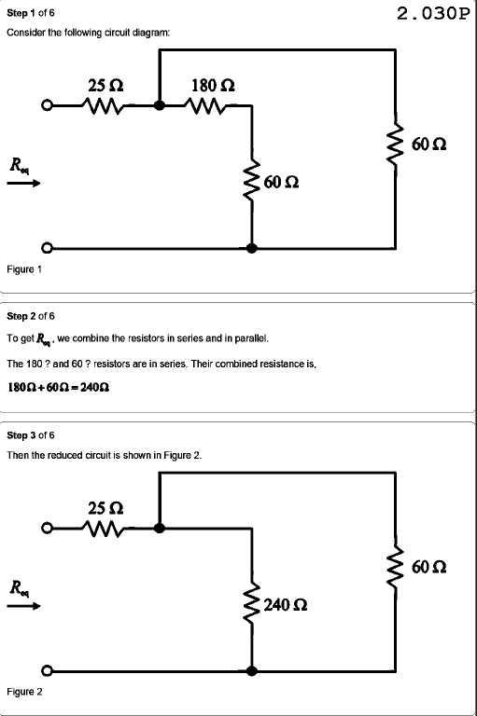
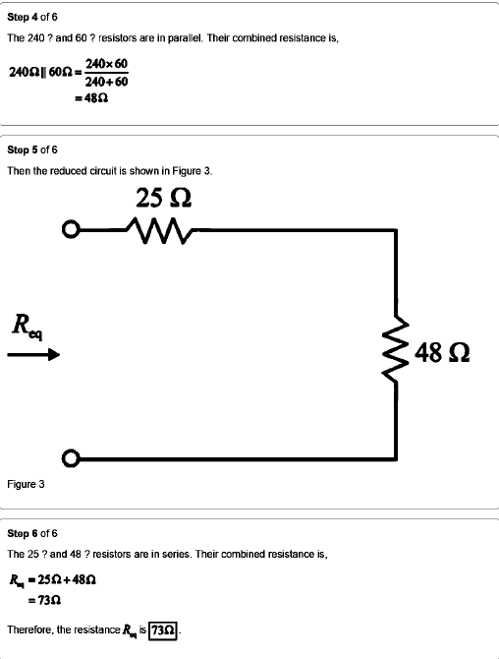
Solution of 2.30:
Reference: Sadiku_Exercise_Problem_2.30

Slide 22
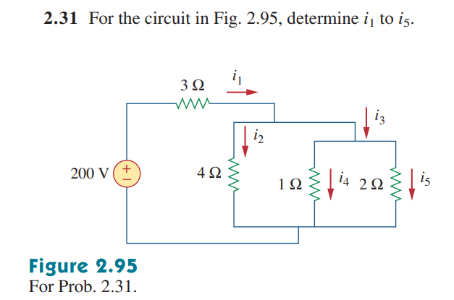
Math Problem Practice:
Reference: Sadiku_Exercise_Problem_2.31

Slide 23
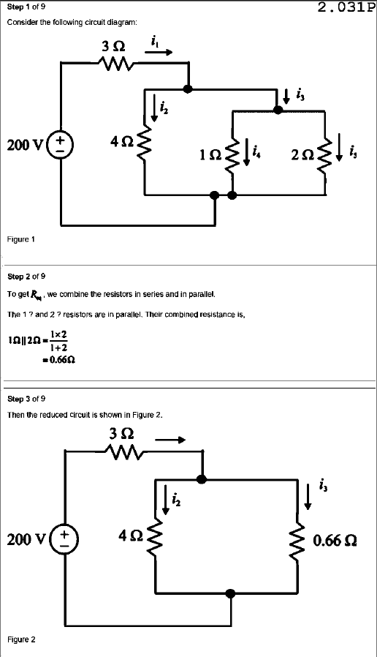
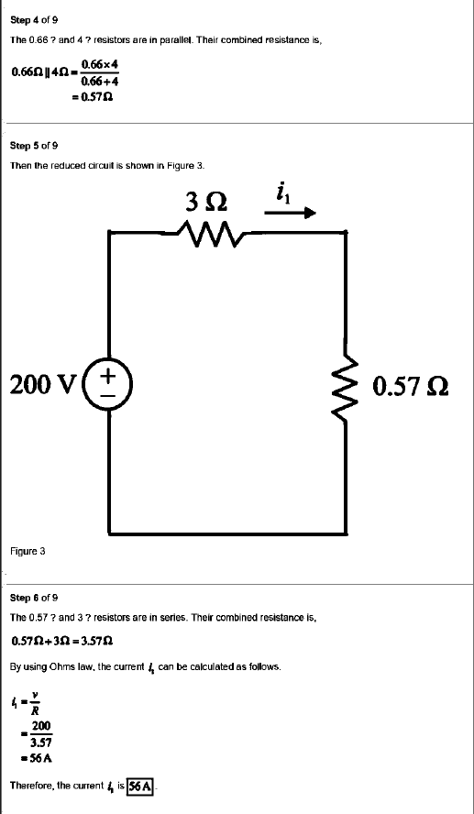
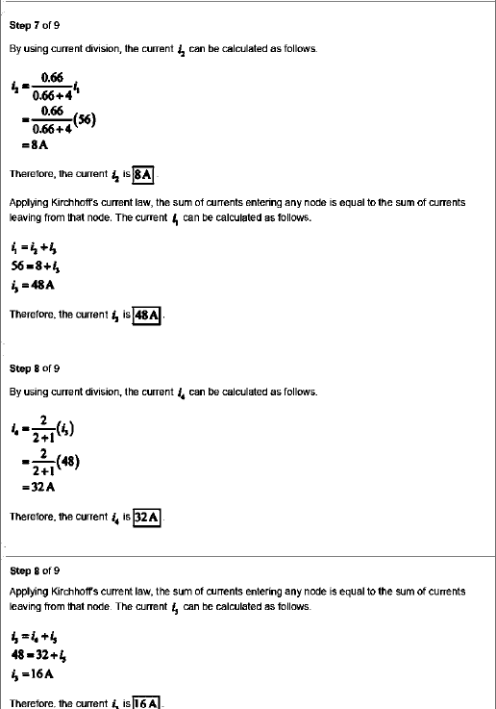
Solution of 2.31:
Reference: Sadiku_Exercise_Problem_2.31

Slide 24
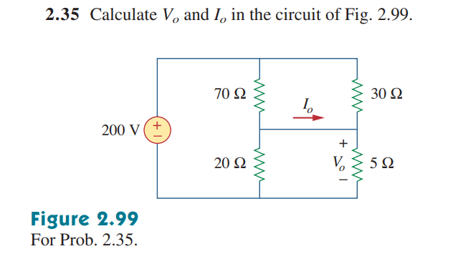
Math Problem Practice:
Reference: Sadiku_Exercise_Problem_2.35

Slide 25
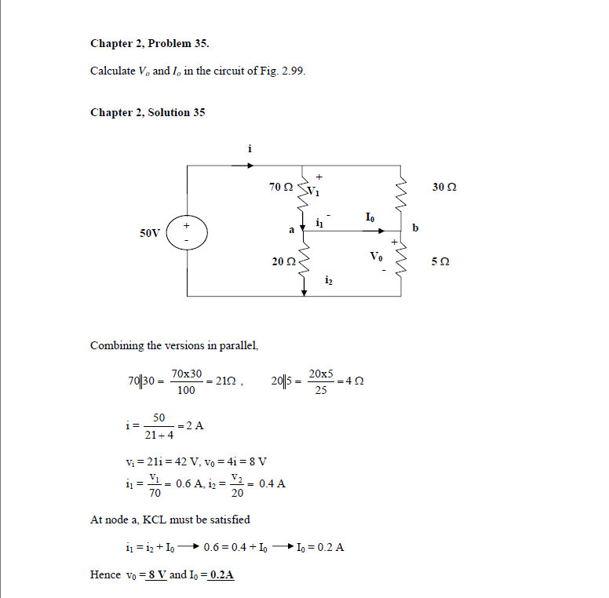
Solution of 2.35:
Reference: Sadiku_Exercise_Problem_2.35

Slide 26
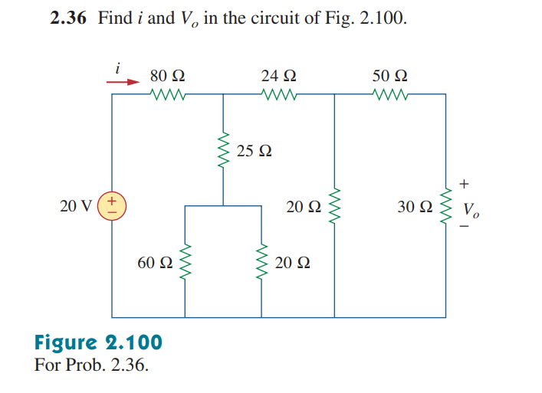
Math Problem Practice:
Reference: Sadiku_Exercise_Problem_2.36

Slide 27
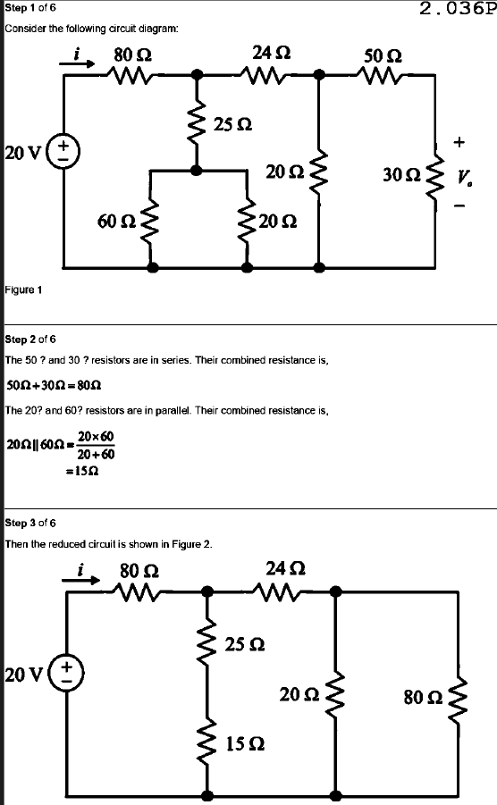
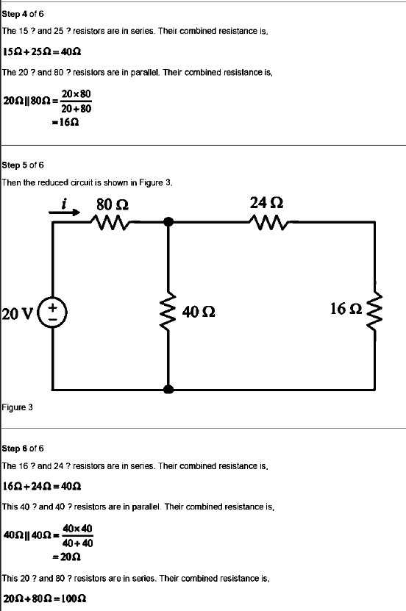
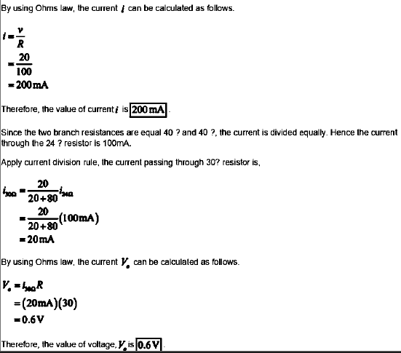
Solution of 2.36:
Reference: Sadiku_Exercise_Problem_2.36

Slide 28
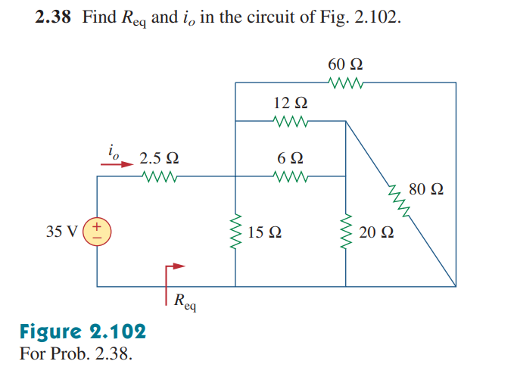
Math Problem Practice:
Reference: Sadiku_Exercise_Problem_2.38

Slide 29
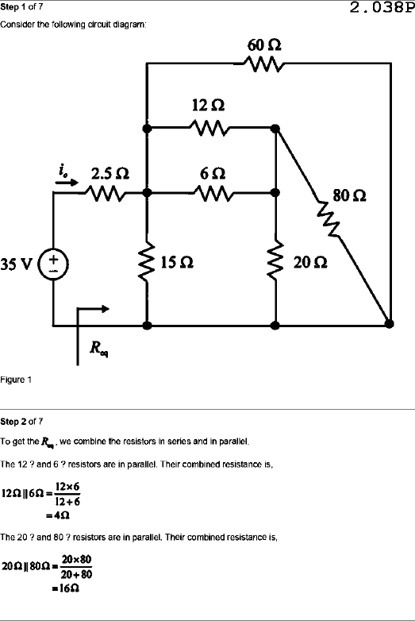
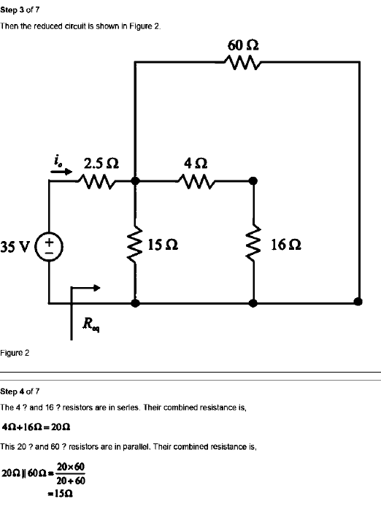
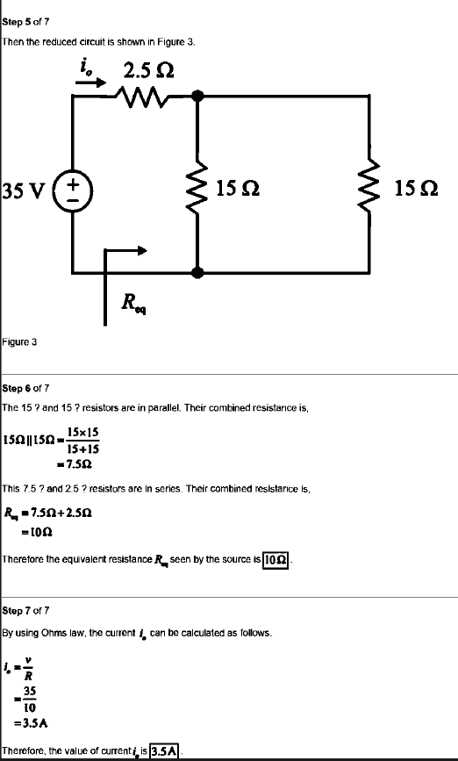
Solution of 2.38:
Reference: Sadiku_Exercise_Problem_2.38

Slide 30
Math to Practice from the Book for Exam
Chapter 2
Example:
2.3, 2.5, 2.6, 2.7, 2.9, 2.10, 2.12, 2.16
Practice Problem:
2.3, 2.5, 2.6, 2.7, 2.9, 2.10, 2.12
Problem:
2.15, 2.16, 2.18, 2.22, 2.23, 2.26, 2.30, 2.31, 2.32, 2.35, 2.36, 2.37, 2.38, 2.39, 2.40, 2.41(**), 2.42, 2.43, 2.44(**), 2.45, 2.46, 2.47(**)
N:B: Please note that the Wye-Delta concept is not in the present syllabus!

Slide 31
Thank You

